Slide 1
Ulinkers
Midterm Presentation
Teh Kaixin
Nicole Goh
Sean Kwok
Nabilah Banu
Chien Shu Yan

Slide 2
Agenda
Introduction
Problem and Solution
Technologies
Project Management
User Testing
X-Factor
Reflections

Slide 3








Nicole Goh
Teh Kaixin
Lead Frontend Developer
Deputy Project Manager
Project Manager
Deputy Quality Assurance
Nabilah Banu
Business Analyst
Deputy Frontend Developer
Sean Kwok
Chien Shu Yan
Lead Backend Developer
Lead Quality Assurance
Professor Steven Hoi
Linda Siow
Supervisor
Sponsor
Introduction
Problem and Solution
Technologies
Project Management
User Testing
X-Factor
Reflections

Slide 4



Operating since 1996
Our Sponsor
Medical concierge provider:
Clinic & hospitalisation arrangements
Treatment plans & price estimates
Travel arrangements & visas
Standby assistance in Singapore
Ulink Assist Pte Ltd
Patients:
Indonesia, Malaysia, Cambodia, Vietnam, Myanmar & China
15 Employees

Slide 5
Problem
No platform for Ulink to recommend screenings to client
Difficult to determine engagements with stakeholders
Unable to keep track of teams’ performances
Introduction
Problem and Solution
Technologies
Project Management
User Testing
X-Factor
Reflections
Notes:
currently customers come to find ulink for screenings and there is no platform for ulink to push screenings to customers.

Slide 6
Ulink Reporting System
Reporting tools for decision making
(Specific KPI of different teams, Gender and Age, Ranking of stakeholders, Index (points) )
1
2
Screenings recommendation and reminder
3
Dashboard displays statistics and overview
Introduction
Problem and Solution
Technologies
Project Management
User Testing
X-Factor
Reflections

Slide 7
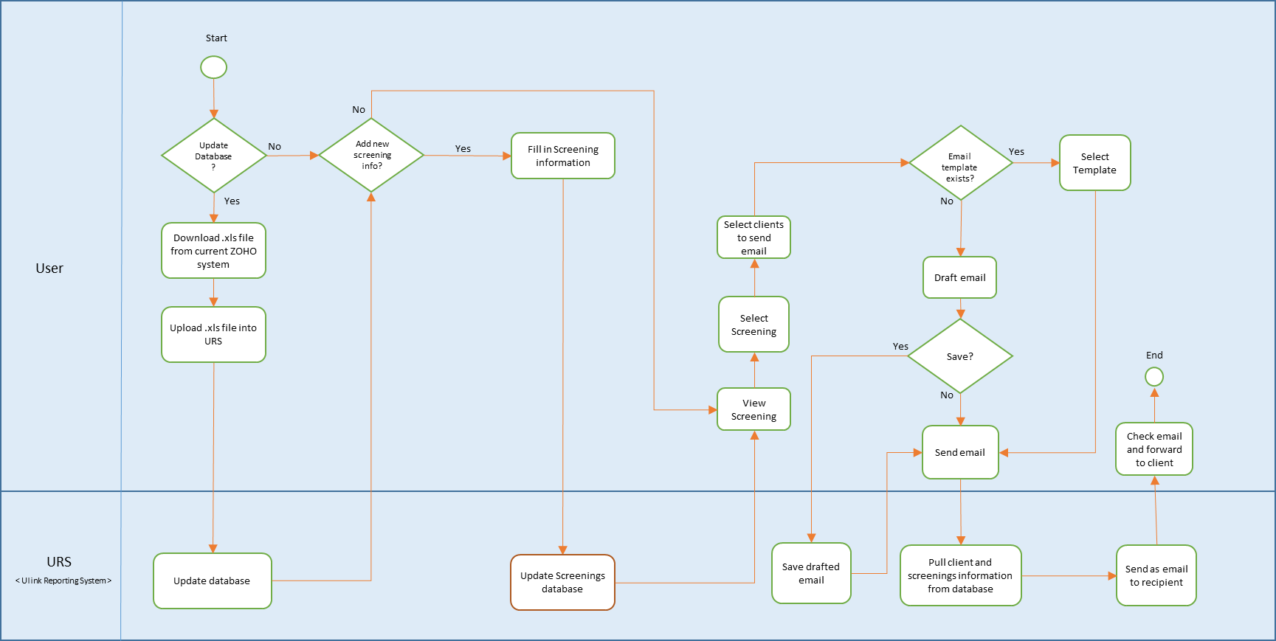
To-Be Workflow (Screenings and Email)
Introduction
Problem and Solution
Technologies
Project Management
User Testing
X-Factor
Reflections

Slide 8
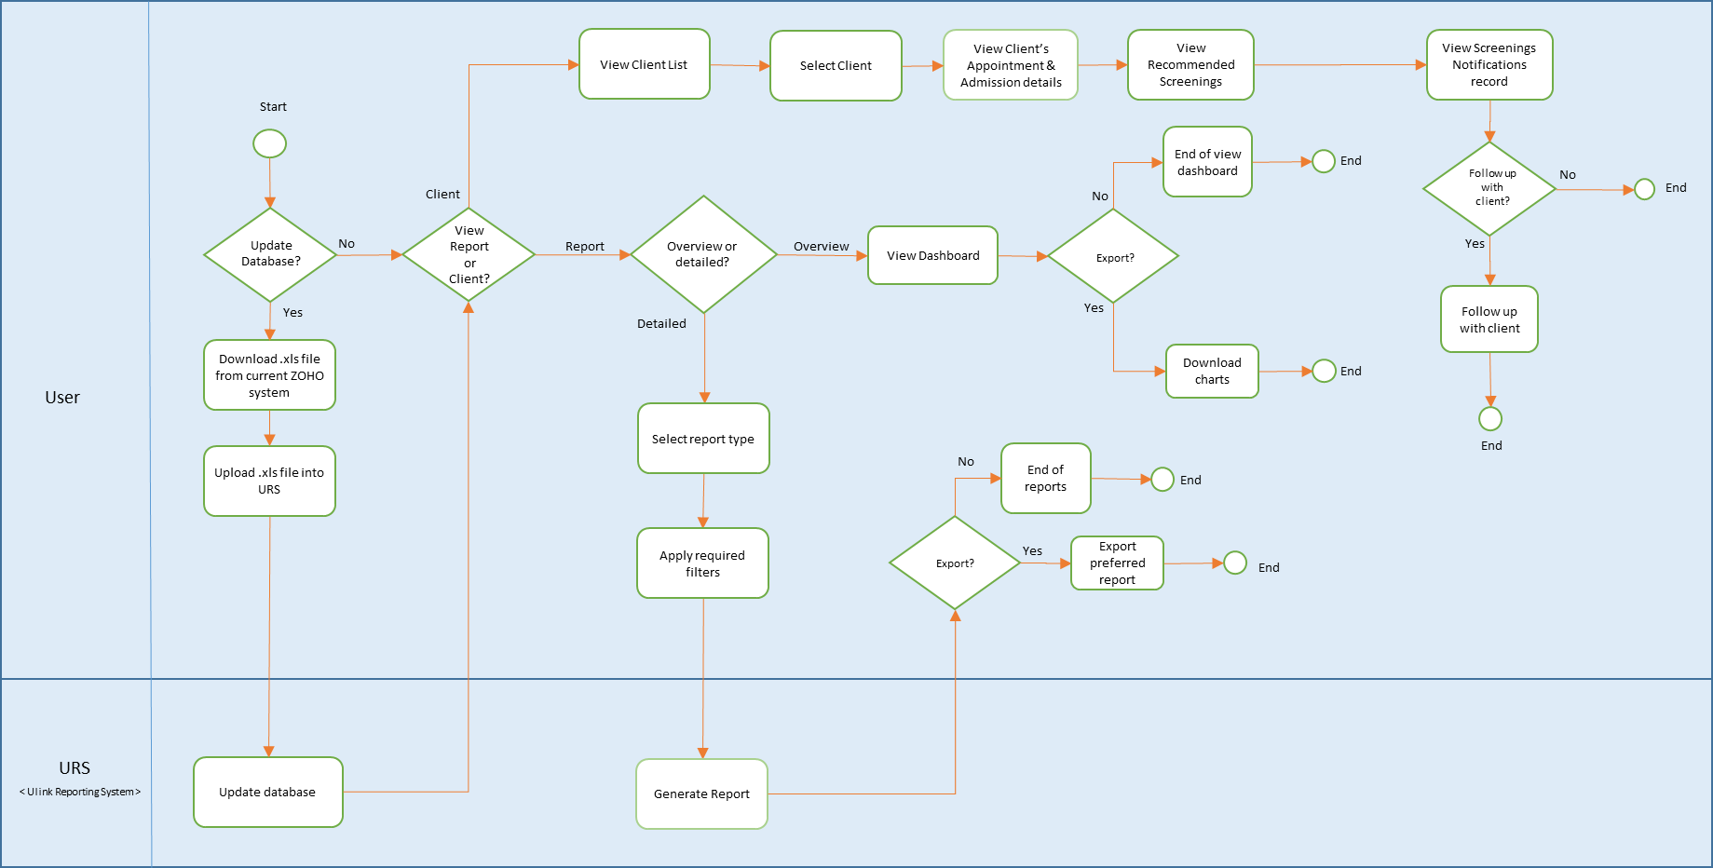
To-Be Workflow (Client, Dashboard and Reports)
Introduction
Problem and Solution
Technologies
Project Management
User Testing
X-Factor
Reflections

Slide 9

DEMONSTRATION
Introduction
Problem and Solution
Technologies
Project Management
User Testing
X-Factor
Reflections

Slide 10

Technology
Architecture Diagram
Technical Complexity

Slide 11












Architecture Diagram
FRONTEND
HTTP GET POST JSON
BACKEND
OTHER SERVICES
JSON OUTPUT
Introduction
Problem and Solution
Technologies
Project Management
User Testing
X-Factor
Reflections

Slide 12
TECHNICAL COMPLEXITY
Introduction
Problem and Solution
Technologies
Project Management
User Testing
X-Factor
Reflections

Slide 13
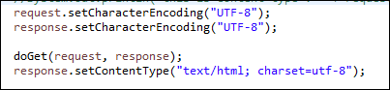
Technical Complexity
Encoding Character
Problems:
Default Encoding value for getParameter - ISO-8859-1
Unable to read UTF-8 encoding value
Solution:
Change database storing format and encoding value for getParameter
Introduction
Problem and Solution
Technologies
Project Management
User Testing
X-Factor
Reflections

Slide 14
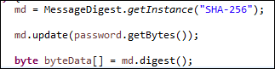
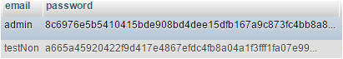
Technical Complexity
Security
Problems:
To prevent client information being compromised
Solution:
Encrypt password using SHA-256
Introduction
Problem and Solution
Technologies
Project Management
User Testing
X-Factor
Reflections

Slide 15
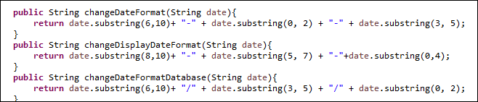
Technical Complexity
Different Date Formats
Problems:
Many different types of date format required
Solution:
Joda Time library and calendar from Java .
Introduction
Problem and Solution
Technologies
Project Management
User Testing
X-Factor
Reflections

Slide 16
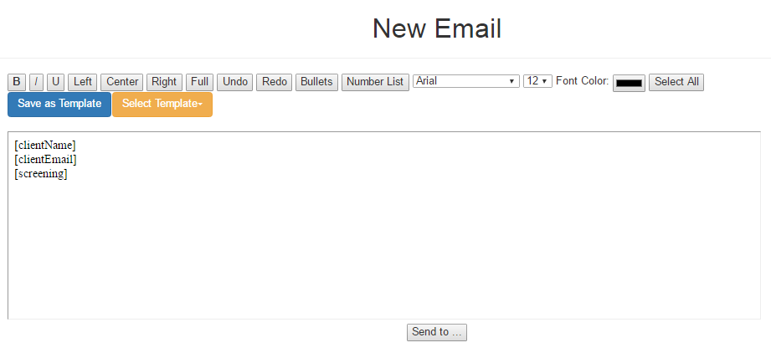
Technical Complexity
Text Editor (iFrame)
Problems:
Cannot preserve the HTML format
Edit mode not user-friendly
Cannot save pasted text directly
Looks “Raw”
Introduction
Problem and Solution
Technologies
Project Management
User Testing
X-Factor
Reflections

Slide 17
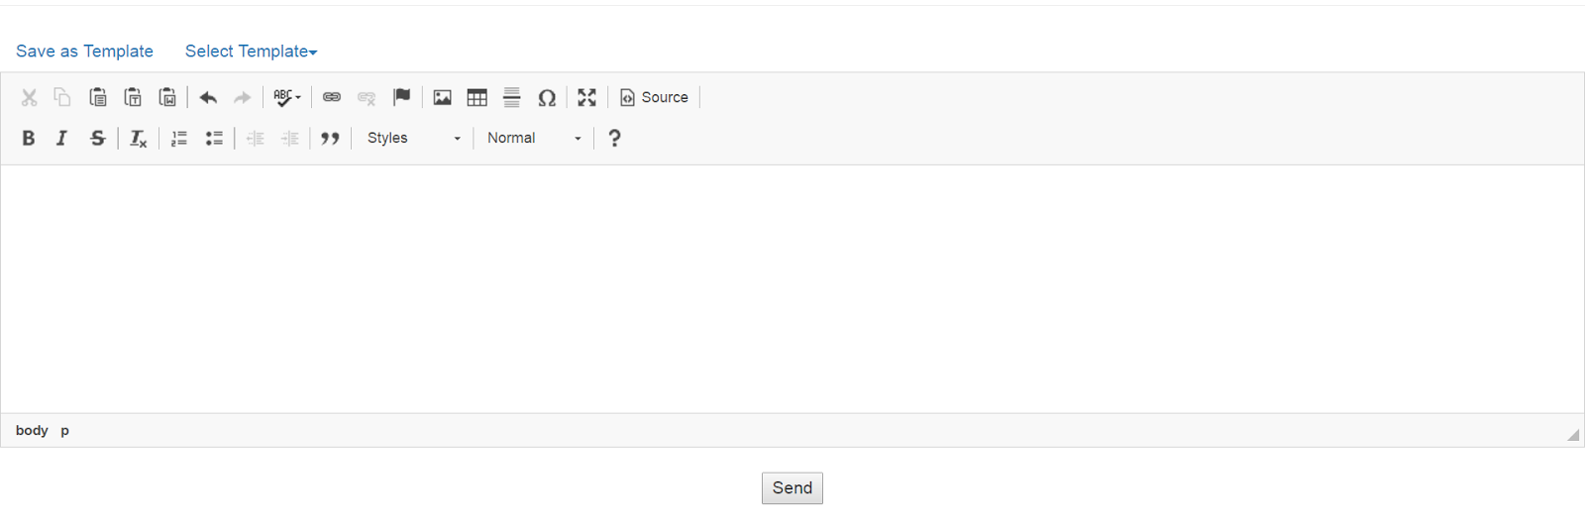
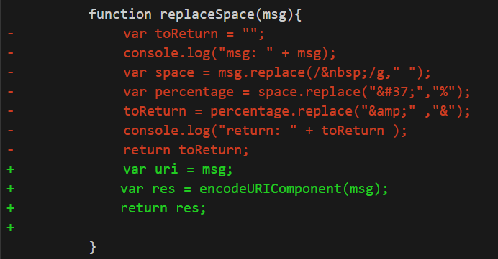
Technical Complexity
Problem:
Need to replace symbols to preserve original format
Solution:
EncodeURIComponent
Introduction
Problem and Solution
Technologies
Project Management
User Testing
X-Factor
Reflections

Slide 18

Project Management

Slide 19
Project Progress
14 Iterations
4 User Testing
100% Completed
Introduction
Problem and Solution
Technologies
Project Management
User Testing
X-Factor
Reflections
Notes:
10/34

Slide 20
Project Handover
7 April 2017
User guide
Source code Database with current data
Introduction
Problem and Solution
Technologies
Project Management
User Testing
X-Factor
Reflections
Notes:
10/34

Slide 21
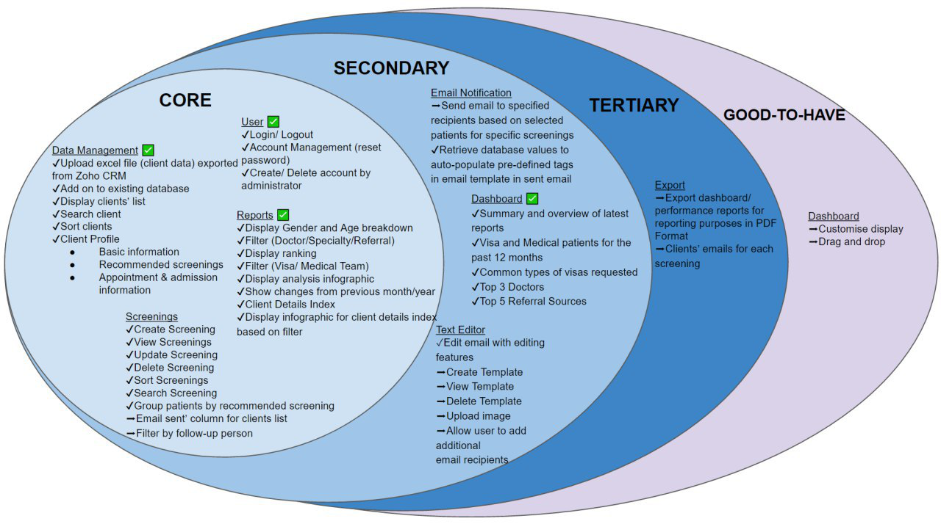
Mid-term Scope
Introduction
Problem and Solution
Technologies
Project Management
User Testing
X-Factor
Reflections
Notes:
10/34

Slide 22
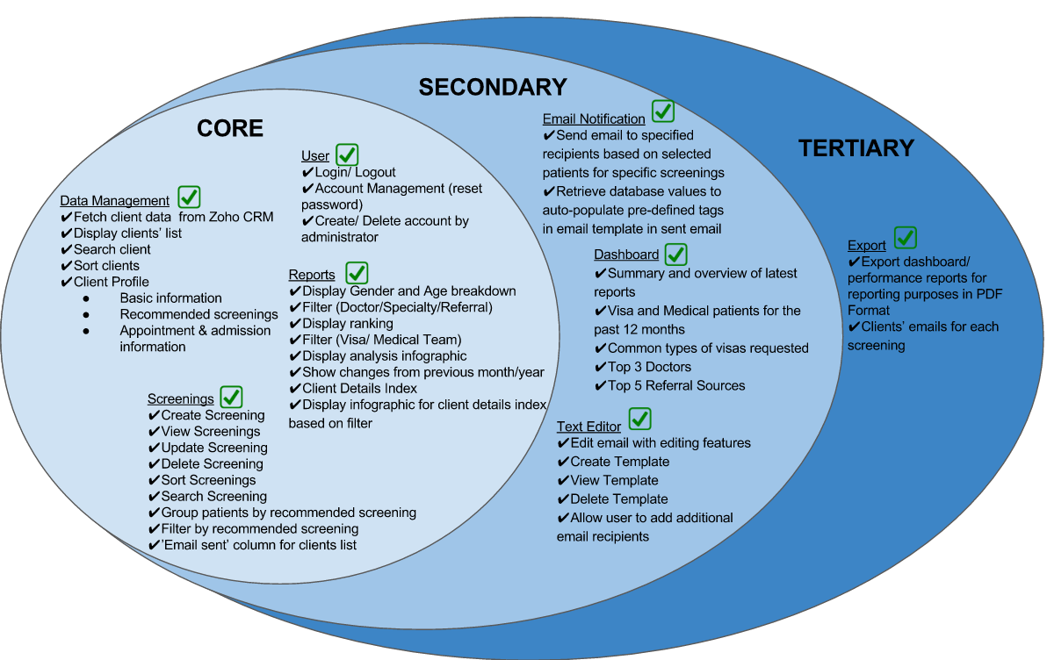
Final Scope
100%
Completed
Introduction
Problem and Solution
Technologies
Project Management
User Testing
X-Factor
Reflections

Slide 23
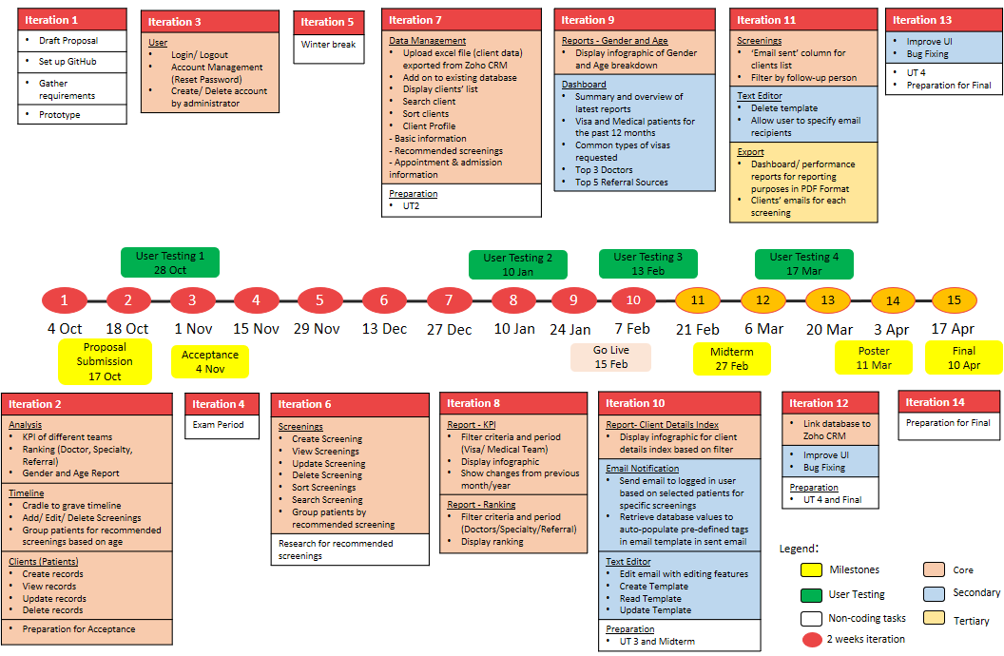
Midterm Schedule
Introduction
Problem and Solution
Technologies
Project Management
User Testing
X-Factor
Reflections

Slide 24
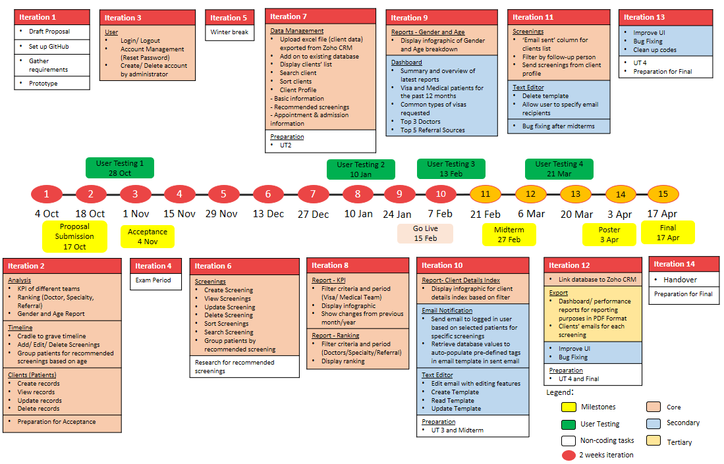
Final Schedule
Introduction
Problem and Solution
Technologies
Project Management
User Testing
X-Factor
Reflections

Slide 25
Change Management

Slide 26
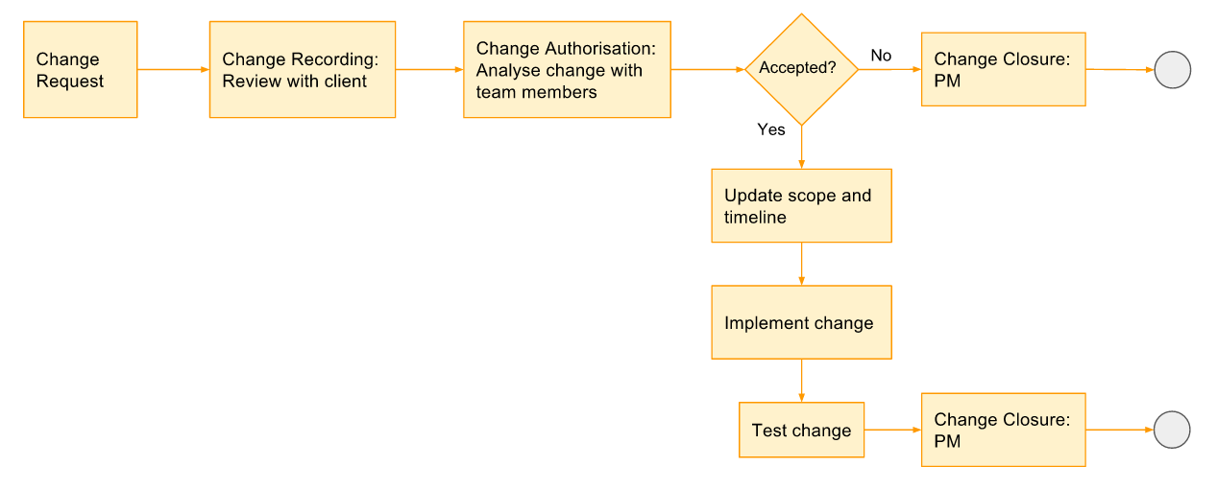
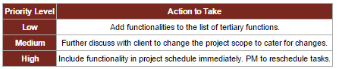
Process
Introduction
Problem and Solution
Technologies
Project Management
User Testing
X-Factor
Reflections

Slide 27


Changes
Added/Modified | Removed
Report – Index (Point System) | Doctors
Database – take in additional fields from excel file | Tasks
CRUD Templates feature | Services
Text editor allows selection of recipients | SMS Notification
Text editor allows upload of images | Rules
Screenings – email sent column | Invoices
Screenings – follow up person filter | Currency Conversion
Export client emails in excel | Creating additional tabs/ modules
Introduction
Problem and Solution
Technologies
Project Management
User Testing
X-Factor
Reflections

Slide 28
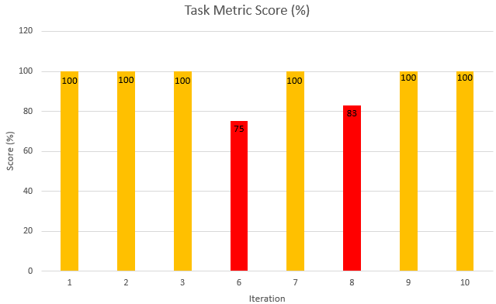
Task Metric
Introduction
Problem and Solution
Technologies
Project Management
User Testing
X-Factor
Reflections

Slide 29
Task Metric
Iteration | Iteration 6 | Iteration 8
Actual : Planned (Tasks) | 6 : 8 | 5 : 6
TM Score | 75% | 83%
Problem | Bugs: Screenings Edit screenings – unable to update screenings Delete button deletes a particular screening for both genders | Bugs: Reports – KPI and Ranking Incorrect data displayed UI – date picker, filter values
Action taken | Shifted uploading data to next Iteration | Shifted Gender - Age report to next Iteration
Introduction
Problem and Solution
Technologies
Project Management
User Testing
X-Factor
Reflections

Slide 30
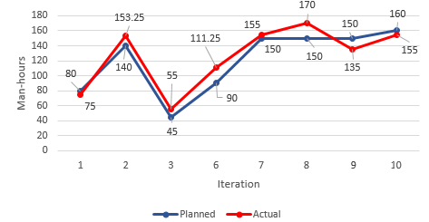
Effort Metric
Introduction
Problem and Solution
Technologies
Project Management
User Testing
X-Factor
Reflections
Notes:
2 – before acceptance, underestimate hours required for preparation
6 – CRUD screenings not as easy as we thought
8 – Iter 7 Ranking was shifted to iter 8. hence iter 8 has ranking and kpi functions to complete
9 – Over estimated time required for dashboard + gender and age report (more of charts and display)

Slide 31
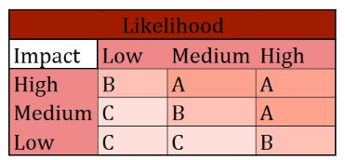
Risk Management
Project Management Risk
Allocation of too much/ little time for development of functions
Buffer days before submission
Allocate more time for more complex tasks
Introduction
Problem and Solution
Technologies
Project Management
User Testing
X-Factor
Reflections

Slide 32
Risk Management
Client Risk
Change in client’s requirement
Meet & update client weekly
Ensure that development is on par with client’s requirements
Present client prototype before development
Introduction
Problem and Solution
Technologies
Project Management
User Testing
X-Factor
Reflections

Slide 33
Risk Management
Technical Risk
Unfamiliar with coding language
E,g. Javascript, JQuery
More experienced developer to share knowledge
Developers to research & learn technologies
Assistant developer to help with complex tasks
Introduction
Problem and Solution
Technologies
Project Management
User Testing
X-Factor
Reflections

Slide 34

Quality Assurance
Internal Testing
User Testing

Slide 35
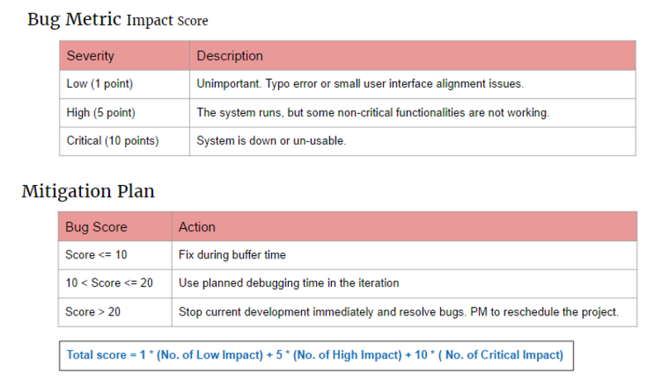
Bug Metric
Introduction
Problem and Solution
Technologies
Project Management
User Testing
X-Factor
Reflections

Slide 36
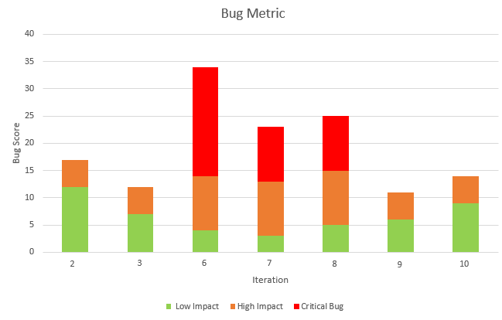
Bug Metric
2
1
1
1
2
2
2
1
12
1
1
7
9
4
5
6
3
Introduction
Problem and Solution
Technologies
Project Management
User Testing
X-Factor
Reflections

Slide 37
User Testing 1
Purpose: Gather UI feedback & detect usability issues
Participant: Linda (Sponsor)
Date: 28 October 2016
Time: 4.00pm
Scope:
Client Creation Module
Timeline Module
Reports Module
KPI
Ranking
Gender - Age Report
Introduction
Problem and Solution
Technologies
Project Management
User Testing
X-Factor
Reflections
Notes:
Client prefers to choose which patient to send email to instead of automated sending of email
Analysis results to be in numbers

Slide 38


UT 1 Feedback
Easy to navigate
Timeline for screenings design is not intuitive
Naming of columns and fields are confusing
Introduction
Problem and Solution
Technologies
Project Management
User Testing
X-Factor
Reflections
Notes:
Client prefers to choose which patient to send email to instead of automated sending of email
Analysis results to be in numbers

Slide 39
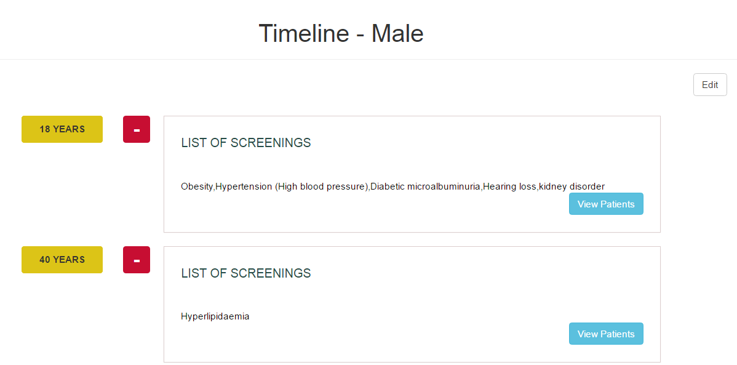
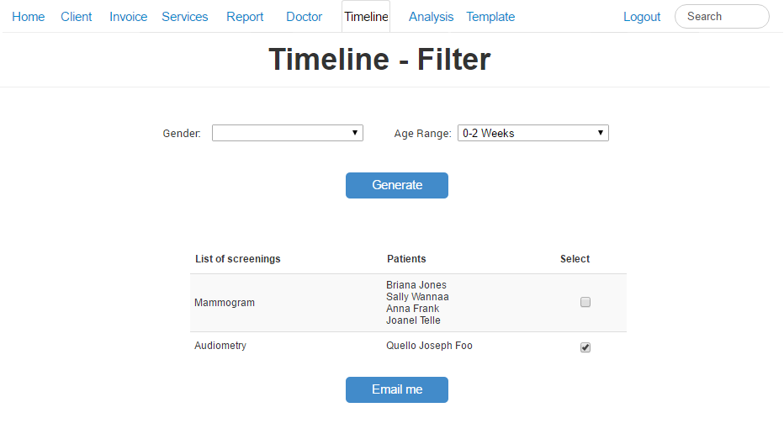

UT 1 Feedback
Timeline display is not intuitive, user suggested to change to table format
Stick to one color scheme
Client prefers to choose which patient to send email to instead of automated sending of email
Before
After
Introduction
Problem and Solution
Technologies
Project Management
User Testing
X-Factor
Reflections

Slide 40
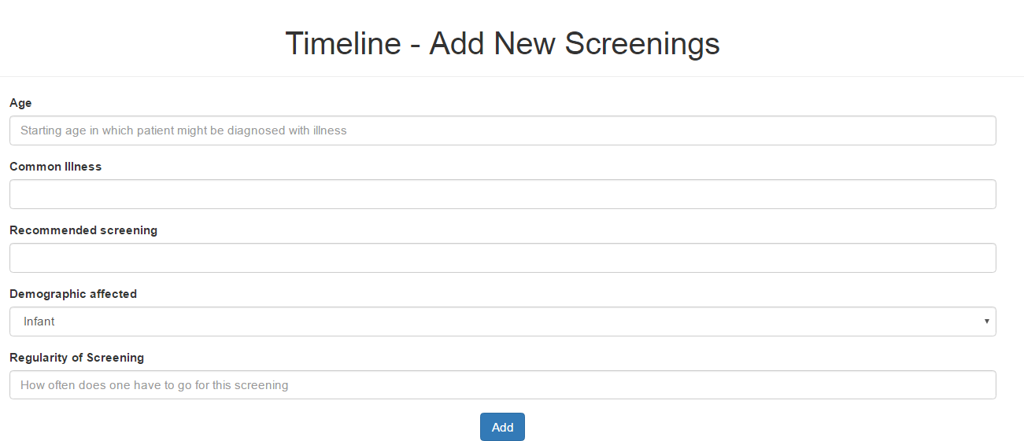
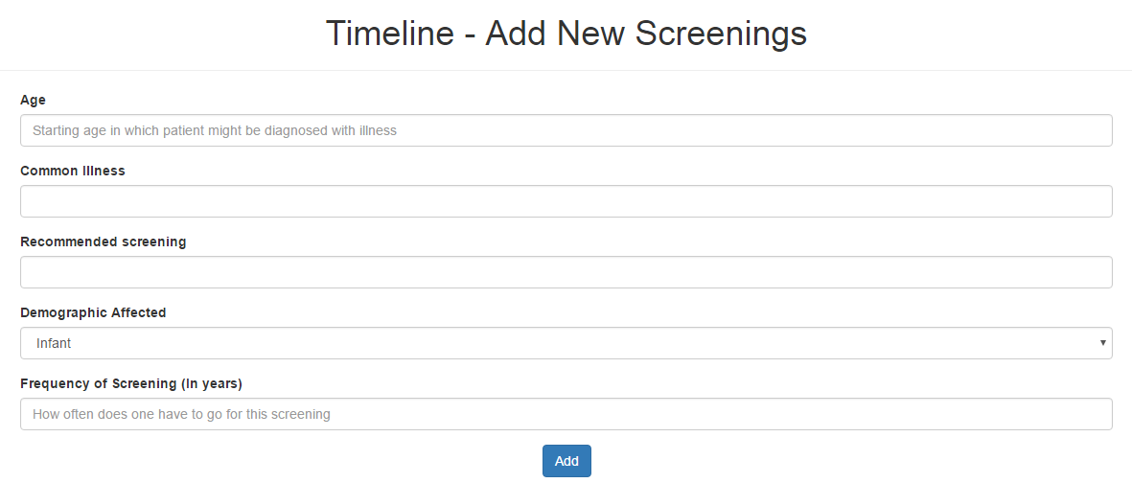
UT 1 Feedback
Rename Regularity field to Frequency of Screening (In Years) for easy understanding
Before
After
Introduction
Problem and Solution
Technologies
Project Management
User Testing
X-Factor
Reflections

Slide 41
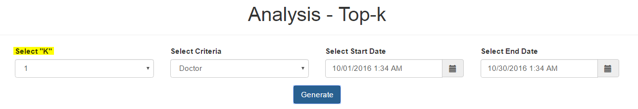

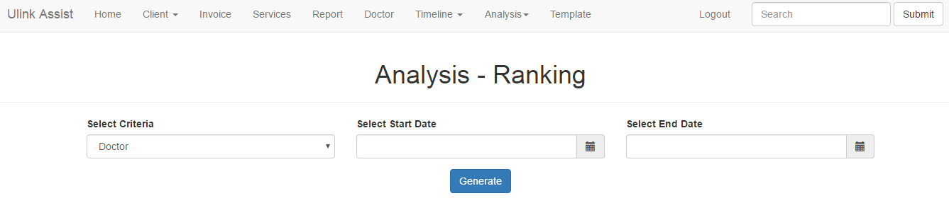
UT 1 Feedback
Top-K function to rename as "Ranking" for easy understanding
List all results in a ranked list instead of selecting “K” value
Before
After
Introduction
Problem and Solution
Technologies
Project Management
User Testing
X-Factor
Reflections

Slide 42
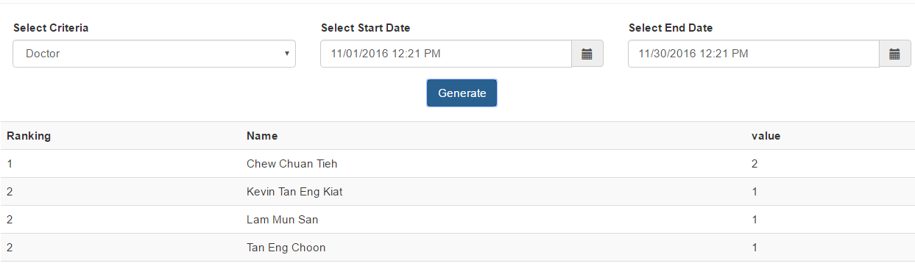
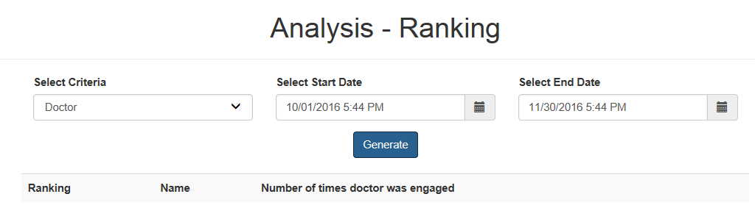
UT 1 Feedback
Before
Confusing naming
After
Introduction
Problem and Solution
Technologies
Project Management
User Testing
X-Factor
Reflections

Slide 43
User Testing 2
Usability & Heuristic Test
Purpose: Identify any usability problems and UI issues
Participant: 5 Ulink employees
Date: 10 January 2017
Time: 3.30pm
Scope:
Login/ Logout
Screenings
Client
Data Management
Introduction
Problem and Solution
Technologies
Project Management
User Testing
X-Factor
Reflections
Notes:
Client prefers to choose which patient to send email to instead of automated sending of email
Analysis results to be in numbers

Slide 44
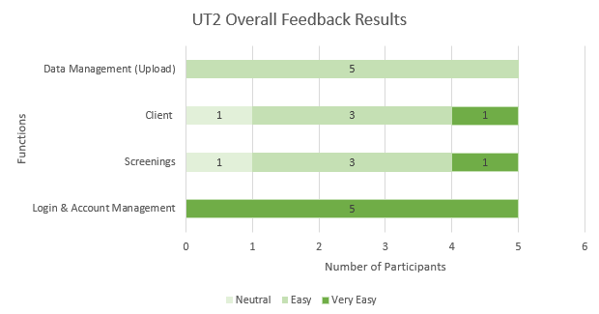
UT 2 Usability
Introduction
Problem and Solution
Technologies
Project Management
User Testing
X-Factor
Reflections
Notes:
Client prefers to choose which patient to send email to instead of automated sending of email
Analysis results to be in numbers

Slide 45
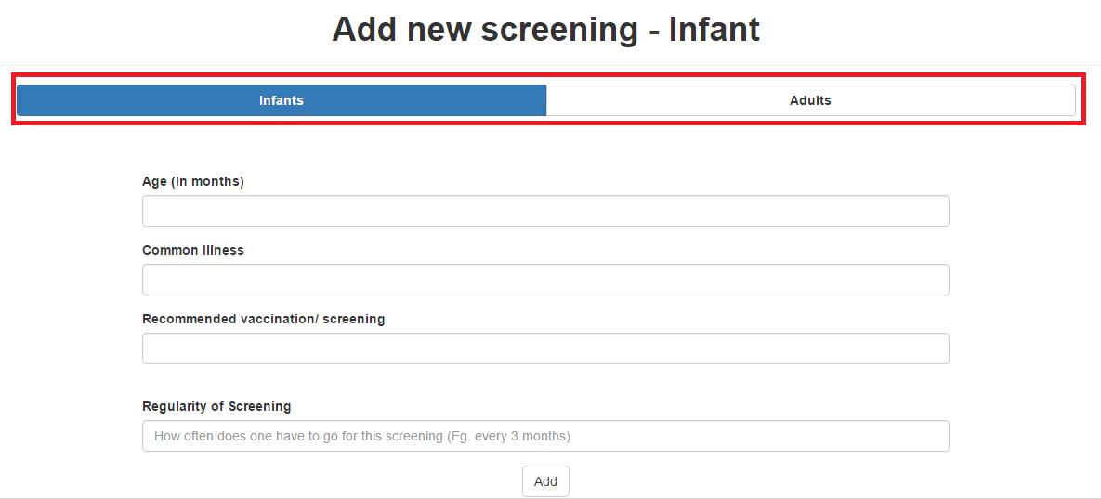
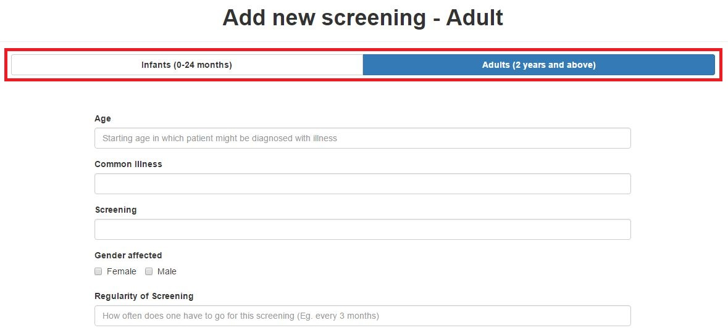
UT 2 Heuristics Improvements
Before
After
Header of Screening form is not specific
Introduction
Problem and Solution
Technologies
Project Management
User Testing
X-Factor
Reflections

Slide 46
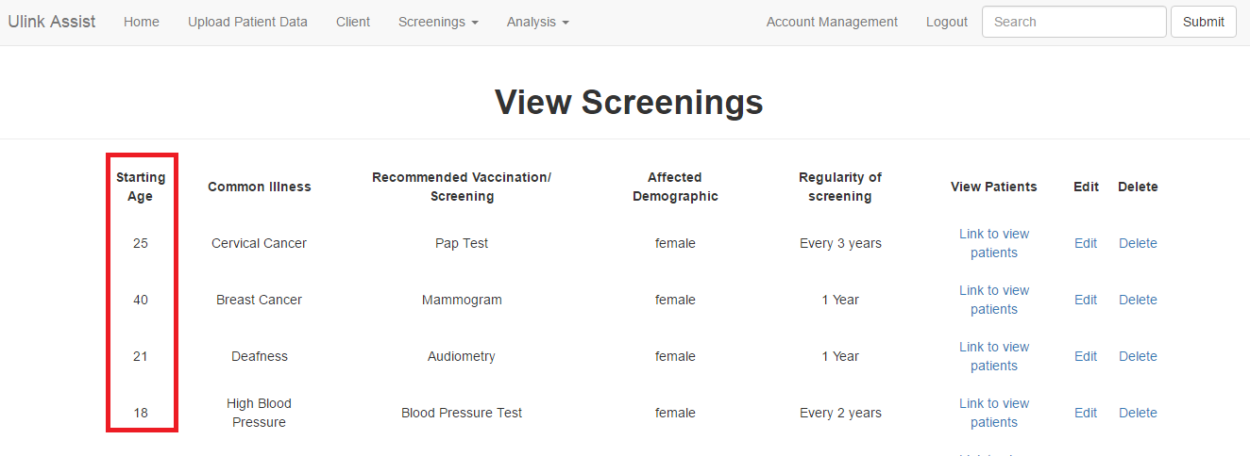
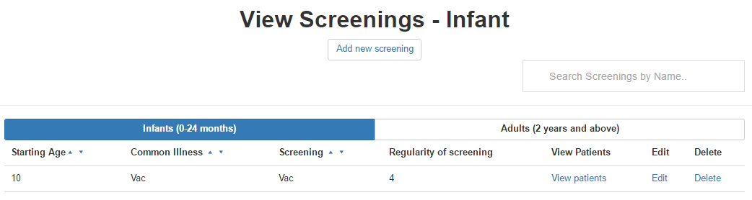
UT 2 Heuristics Improvements
Before
Infants and Adults screenings should have different views
To prevent confusion in age (months, years)
After
Introduction
Problem and Solution
Technologies
Project Management
User Testing
X-Factor
Reflections

Slide 47
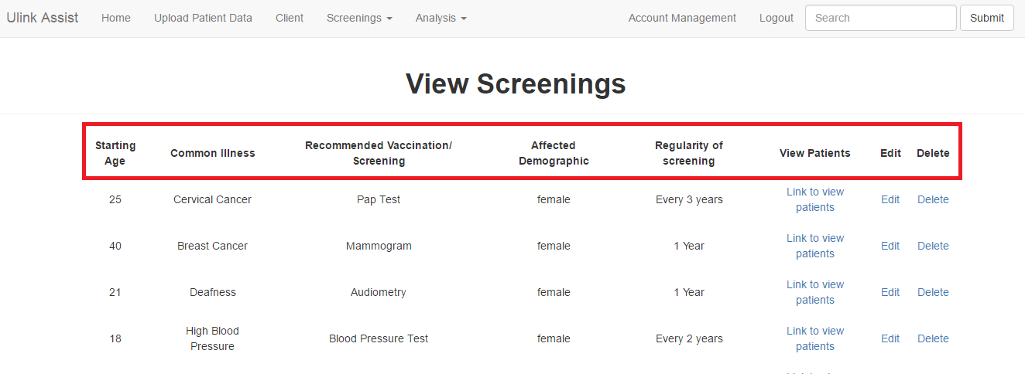
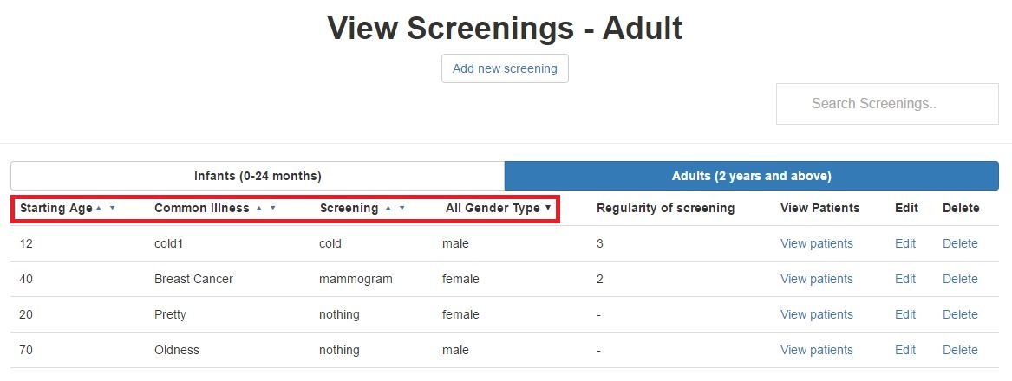
UT 2 Heuristics Improvements
Before
Difficult to search for particular client/ screenings
After
Search and sort features allow easier search
Introduction
Problem and Solution
Technologies
Project Management
User Testing
X-Factor
Reflections

Slide 48

User Testing 3
Purpose:
Gather UI feedback and detect usability issues
Measure time taken for each task
Participant: 6 Ulink employees
Date: 13 February 2017
Time: 4.30pm
Scope:
Data Management
Dashboard Module
Reports Module
KPI, Ranking, Gender-Age
Screenings
Email Notification
Text Editor
Time taken for each task
Introduction
Problem and Solution
Technologies
Project Management
User Testing
X-Factor
Reflections

Slide 49
User Testing 3 Procedure
Login
Data Management (Client)
Reports -KPI
Reports - Ranking
Gender and Age
Screening
Dashboard
Email Recommended Screenings
Introduction
Problem and Solution
Technologies
Project Management
User Testing
X-Factor
Reflections

Slide 50
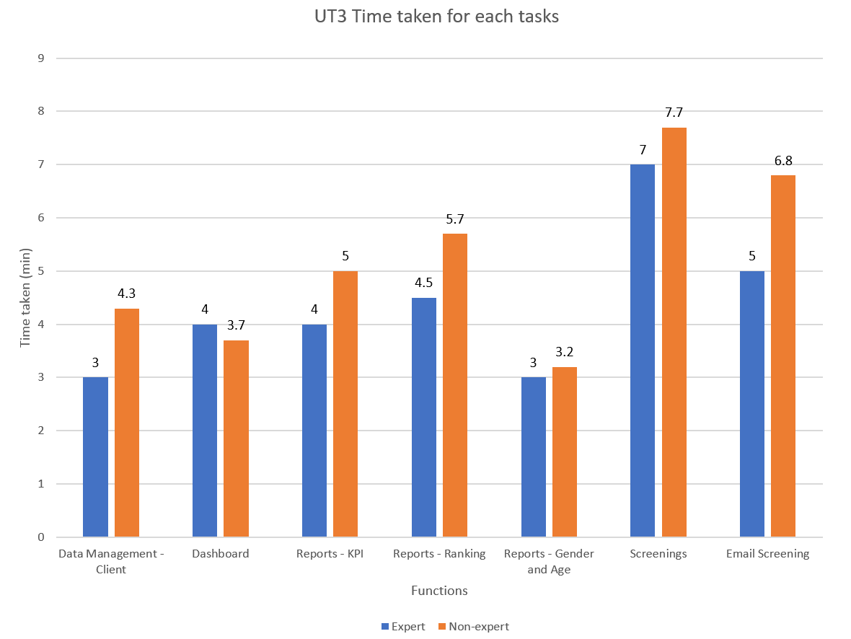
User Testing 3 Results
Non–experts should take not more than 150% of expert’s time taken
Introduction
Problem and Solution
Technologies
Project Management
User Testing
X-Factor
Reflections

Slide 51
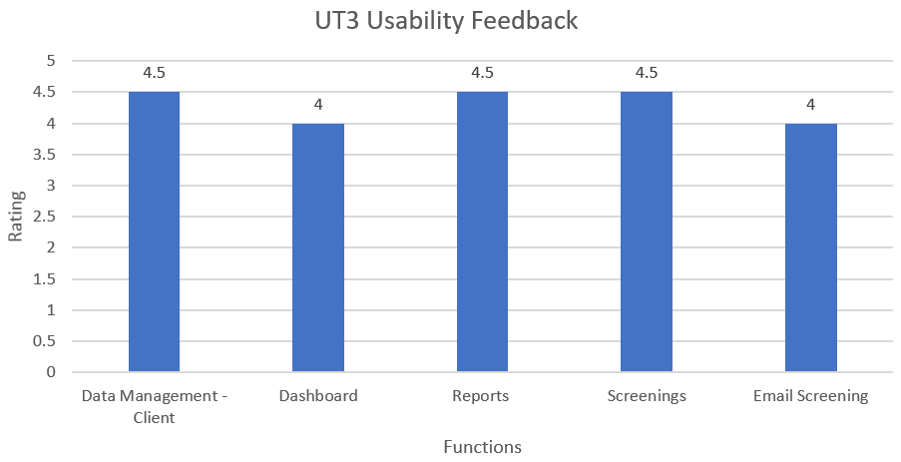
UT 3 Feedback
Very Easy
Very Difficult
Introduction
Problem and Solution
Technologies
Project Management
User Testing
X-Factor
Reflections

Slide 52
UT 3 Feedback
Dashboard & Reports
Visual graphs provides better understanding
User interface
Straightforward & user-friendly
Introduction
Problem and Solution
Technologies
Project Management
User Testing
X-Factor
Reflections

Slide 53
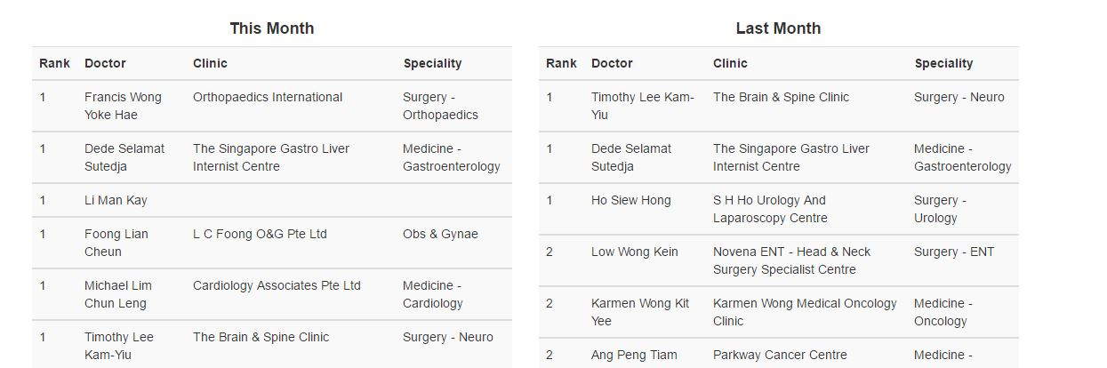
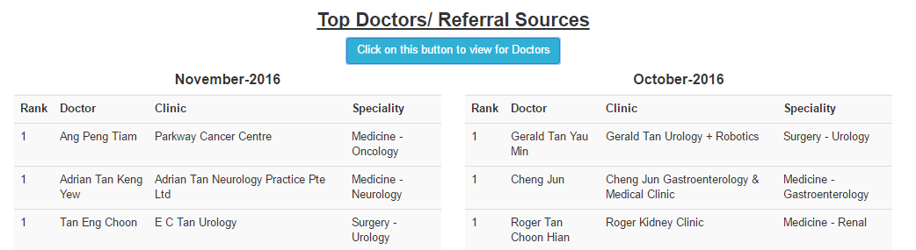
UT 3 Feedback
Before
Change header to be more specific
After
Introduction
Problem and Solution
Technologies
Project Management
User Testing
X-Factor
Reflections

Slide 54
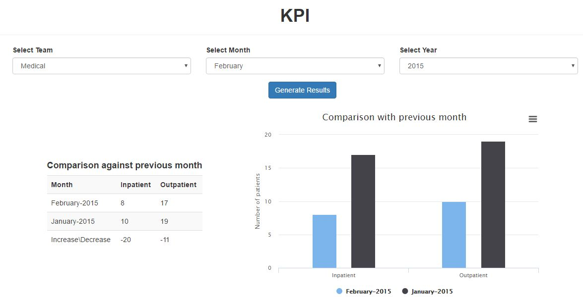
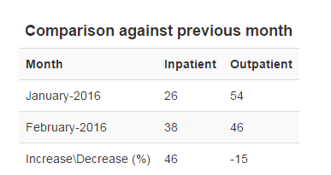
UT 3 Feedback
Before
Include % sign for increase/ decrease in performance
After
Introduction
Problem and Solution
Technologies
Project Management
User Testing
X-Factor
Reflections

Slide 55
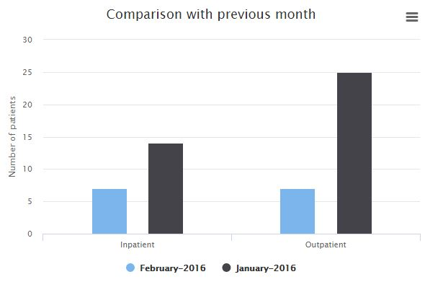
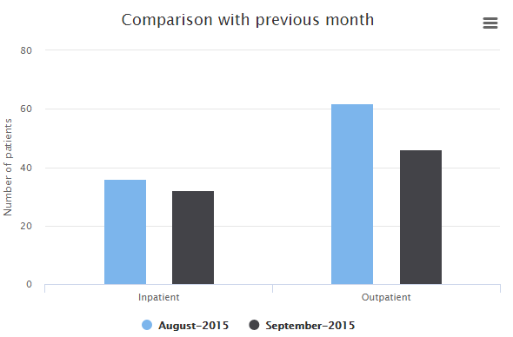
UT 3 Feedback
Before
Display earlier month/ year on the left of the graph
After
Introduction
Problem and Solution
Technologies
Project Management
User Testing
X-Factor
Reflections

Slide 56
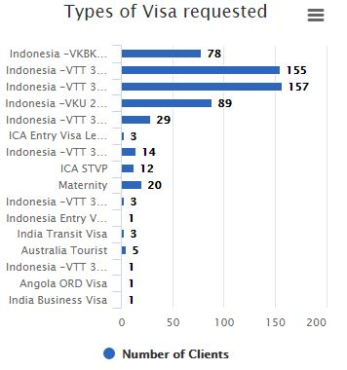
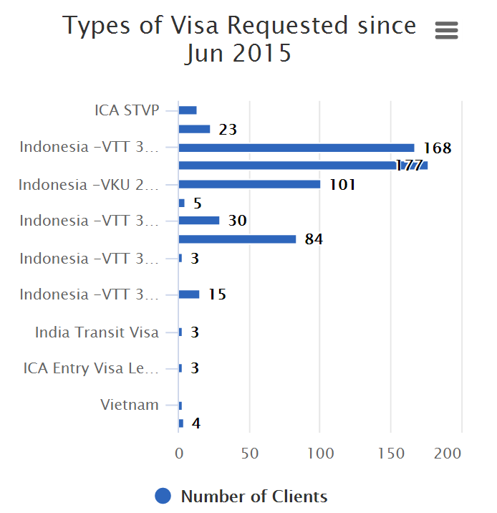
UT 3 Feedback
Before
Unclear of which period this graph is referring to
After
Introduction
Problem and Solution
Technologies
Project Management
User Testing
X-Factor
Reflections

Slide 57
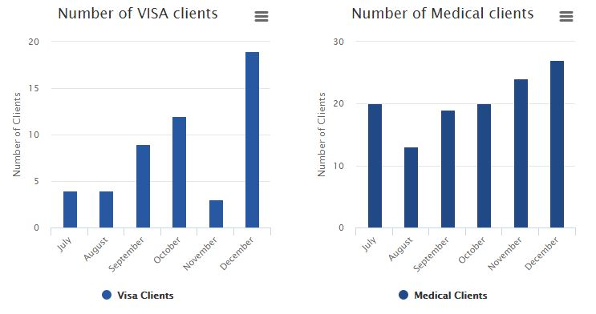
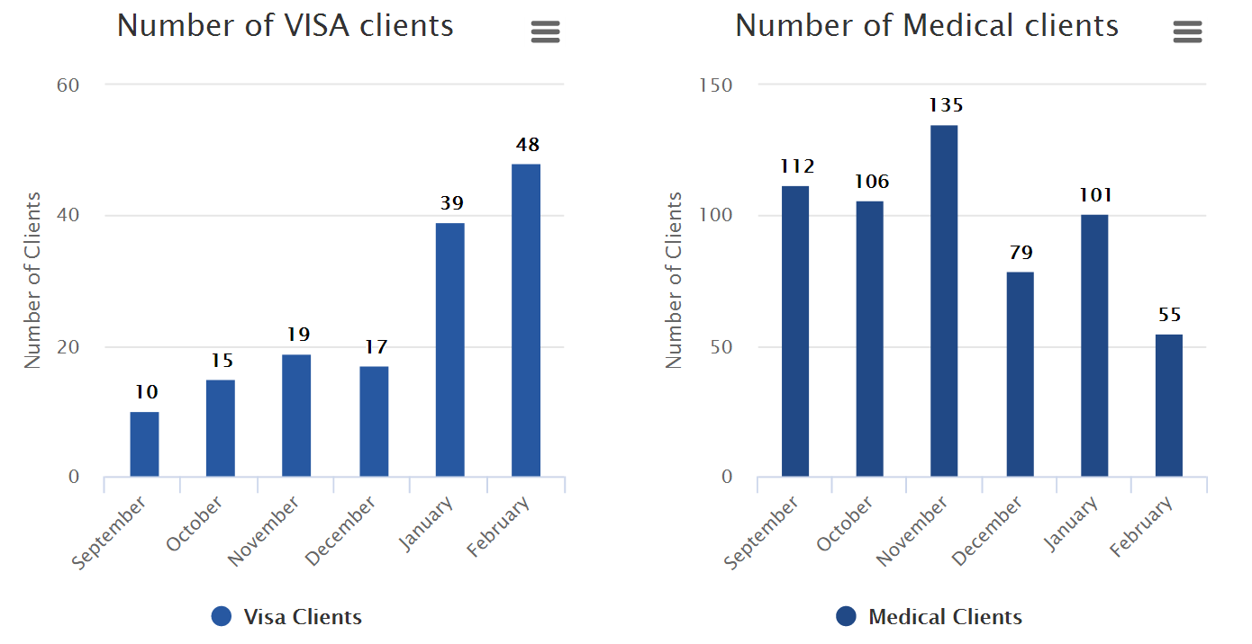
UT 3 Feedback
Before
Data labels added
After
Introduction
Problem and Solution
Technologies
Project Management
User Testing
X-Factor
Reflections

Slide 58
UT 3 Feedback
Before
After
Introduction
Problem and Solution
Technologies
Project Management
User Testing
X-Factor
Reflections

Slide 59

UT Takeaways
Gather perspective & opinions of different users
Continuously work on improving the functions
Introduction
Problem and Solution
Technologies
Project Management
User Testing
X-Factor
Reflections

Slide 60
X-FACTOR
Midterm
At least 60% of clients’ responses
Final
50% more returning clients
Introduction
Problem and Solution
Technologies
Project Management
User Testing
X-Factor
Reflections

Slide 61





Reflections
Shu yan
nicole
I have learnt the importance of conducting User Testing and different users have different expectations of the system
I am more familiar with front-end development and feedback from users are very important to me as they help to make the UI more user-friendly
Sean
Learnt to prioritise changes and adopt suggestions from user so that we can improve the system
Kaixin
Nabilah BANU
Knowing how to prepare for change and understanding business requirements is important to deliver a good product
In addition to gathering user requirements, I’ve learnt more about front-end development as an assistant front-end developer
Introduction
Problem and Solution
Technologies
Project Management
User Testing
X-Factor
Reflections

Slide 62

Thank you

Slide 63
Problem
Unable to keep track of teams’ performances
No platform for Ulink to recommend screenings to client
Views are not optimised
Difficult to determine engagements with stakeholders
Unable to customize reports with required fields
No consolidated overview of required reports
Introduction
Problem and Solution
Technologies
Project Management
User Testing
X-Factor
Reflections
Notes:
currently customers come to find ulink for screenings and there is no platform for ulink to push screenings to customers.

Slide 64




Market Research
Recommended screening based on demographic
Dashboard Reporting (Key performance metrics)
Monitor Departments’ Performance
Ranking (Stakeholder engagements)
Client Profile (Consolidated profile view of each client)
Introduction
Problem and Solution
Technologies
Project Management
User Testing
X-Factor
Reflections

Slide 65
User Testing 3 Procedure
Login
Data Management (Client)
Reports -KPI
Reports - Ranking
Gender and Age
Screening
Dashboard
Email Recommended Screenings
Introduction
Problem and Solution
Technologies
Project Management
User Testing
X-Factor
Reflections

